Slide 1
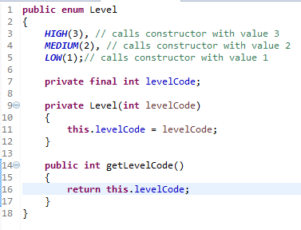
Java Enum
We can add fields to a Java enum. Thus, each constant enum value gets these fields. The field values must be supplied to the constructor of the enum when defining the constants.
Notice how the Java enum in the example above has a constructor which takes an int. The enum constructor sets the int field. When the constant enum values are defined, an int value is passed to the enum constructor.
The enum constructor must be either private or package scope (default). You cannot use public or protected constructors for a Java enum.
We can add methods to a Java enum too
We call an enum method via a reference to one of the constant values Level level = Level.HIGH;
System.out.println(level.getLevelCode()); This code would print out the value 3 which is the value of the levelCode field for the enum constant HIGH.

